Slide 1
EIE228 – IoT for Automation For V Semester Minors in ROBOTICS & AUTOMATION
GCR Code: 4te5zrg
Module 3 & 4
Dr. RM. Kuppan Chetty.,
M.Tech (sensors)., Ph.D (IITM-Robotics), M.I.E., SMIEEE., MIET., C.Eng.,
Professor; School of Mechanical Engineering
Disclaimer: All the materials used in this presentation have been adapted from their respective copyright owners and are used here only for educational purposes

Slide 2
Contents
Enablement Platform for IoT
Application Enablement Platforms
Data Analytics Platforms
Data Virtualization Platforms
Data Visualization Platforms
Emergence of Edge and Fog Clouds
Edge Data Analytics
M2M
Communication and 5G Technologies for supporting IoT in Industry Automation
Software Defined Networks
Network Function Virtualization

Slide 3
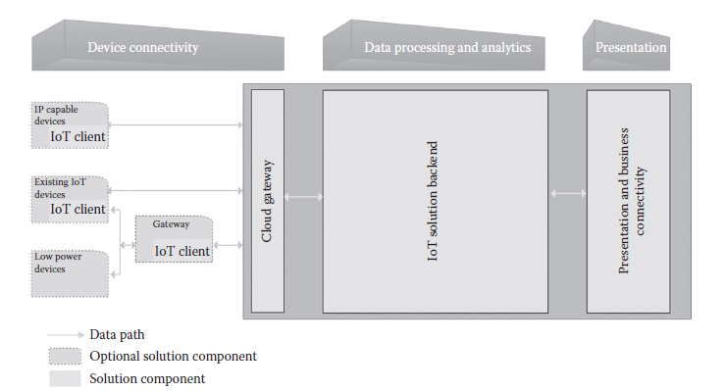
IoT Application Enablement Platforms

Slide 4
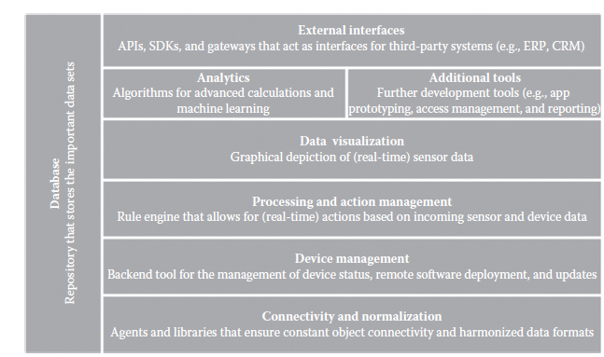
The principal building blocks of IoT AEPs

Slide 5
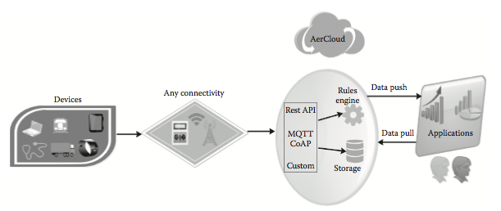
IoT and M2M sensor data platform by AerCloud

Slide 6
IoT and M2M sensor data platform by AerCloud
The key functionality is given as follows:
Secure, reliable collection, storage, analysis, and publishing of M2M and IoT data that scales to millions of users and billions of devices as needed
A rules engine that processes data in near real time that powers sophisticated alerting functionality in applications
Industry standard protocols for collecting data from devices including CoAP and MQTT as well as support for custom protocols
REST API that supports both pushing data to applications and applications pulling data on-demand
The Swisscom M2M AEP offers the following features:
Comfortable remote management of device firmware with a centralized management platform
Secure storage of all sensor and device data in the cloud
Easy monitoring of saved data, reports, and warnings on the basis of graphical user interfaces (GUIs) or programming interfaces (by means of XML and JSON)
An intuitive platform that allows to efficiently use already available applications and to quickly develop newer applications

Slide 7
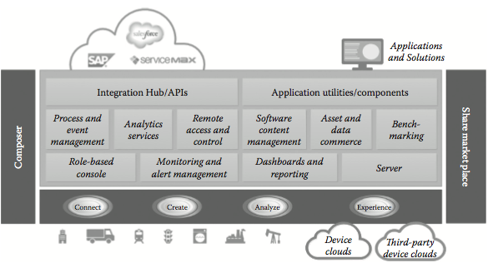
The system architecture of the ThingWorx IoT AEP.

Slide 8
ThingWorx IoT AEP
ThingWorx (http://www.thingworx.com/) is the industry’s leading IoT technology platform.
It enables innovators to rapidly create, debug, and deploy game-changing applications, solutions, and experiences.
The IoT platform enables end users to connect, create, analyze, and experience their ordinary things in totally new ways.
With ThingWorx, users can
◾ Connect any device in the ecosystem to the IoT platform
◾ Remove complexity and develop IoT applications and solutions
◾ Quickly and easily automate complex big data analytics using integrated machine learning (ML) capabilities
◾ Deploy solutions to meet the needs of application/user

Slide 9
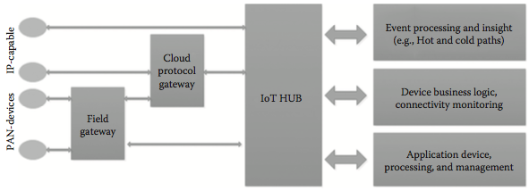
The system architecture for the Microsoft Azure IoT hub

Slide 10
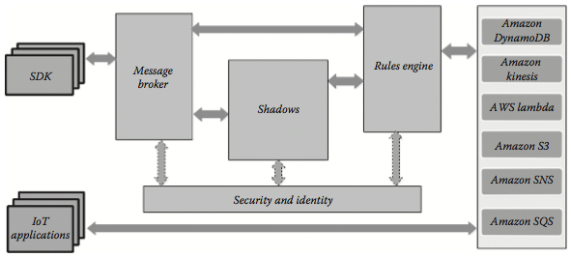
The AWS IoT platform architecture.

Slide 11
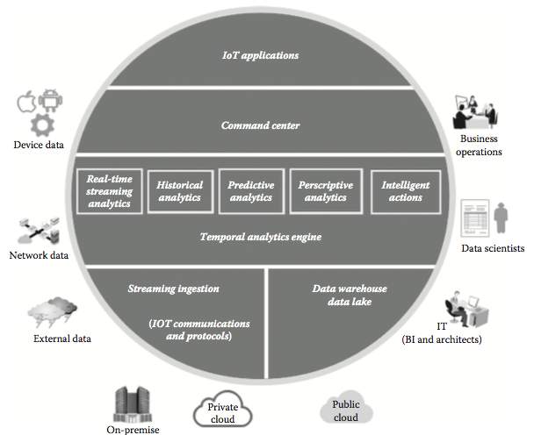
The vitria IoT analytics platform architecture

Slide 12
Data Virtualization Platform
Data virtualization is a kind of modern data integration. It performs many of the same transformation and quality functions as traditional data integration [ETL, data replication, data federation, enterprise service bus (ESB), and so on], but leveraging modern technology to deliver real-time data integration at lower cost, with more speed and agility.
It can replace traditional data integration and reduce the need for replicated data marts and data warehouses in many cases, but not entirely.
Data virtualization is also an abstraction layer and a data services layer. In this sense, it is highly complementary to use between original and derived data sources, ETL, and ESB and other middleware, applications, and devices, whether on-premise or cloud-based, to provide flexibility between layers of information and business technology.

Slide 13
The Key Capabilities Data Virtualization Delivers
1. Logical abstraction and decoupling: Disparate data sources, middleware, and consuming applications that use or expect specific platforms and interfaces, formats, schema, security protocols, query paradigms, and other idiosyncrasies can now interact easily through data virtualization.
2. Data federation on steroids: Data federation is a subset of data virtualization, but now enhanced with more intelligent real-time query optimization, caching, in-memory, and hybrid strategies that are automatically (or manually) chosen based on source constraints, application need, and network awareness.
3. Semantic integration of structured and unstructured: Data virtualization is one of the few technologies that bridge the semantic understanding of unstructured and web data with the schema-based understanding of structured data to enable integration and data quality improvements.
4. Agile data services provisioning: Data virtualization promotes the API economy. Any primary, derived, integrated, or virtual data source can be made accessible in a different format or protocol than the original, with controlled access in a matter of minutes.
5. Unified data governance and security: All data are made discoverable and integratable easily through a single virtual layer, which exposes redundancy and quality issues faster. Although they are addressed, data virtualization imposes data model governance and security from source to output data services and consistency in integration and data quality rules.

Slide 14
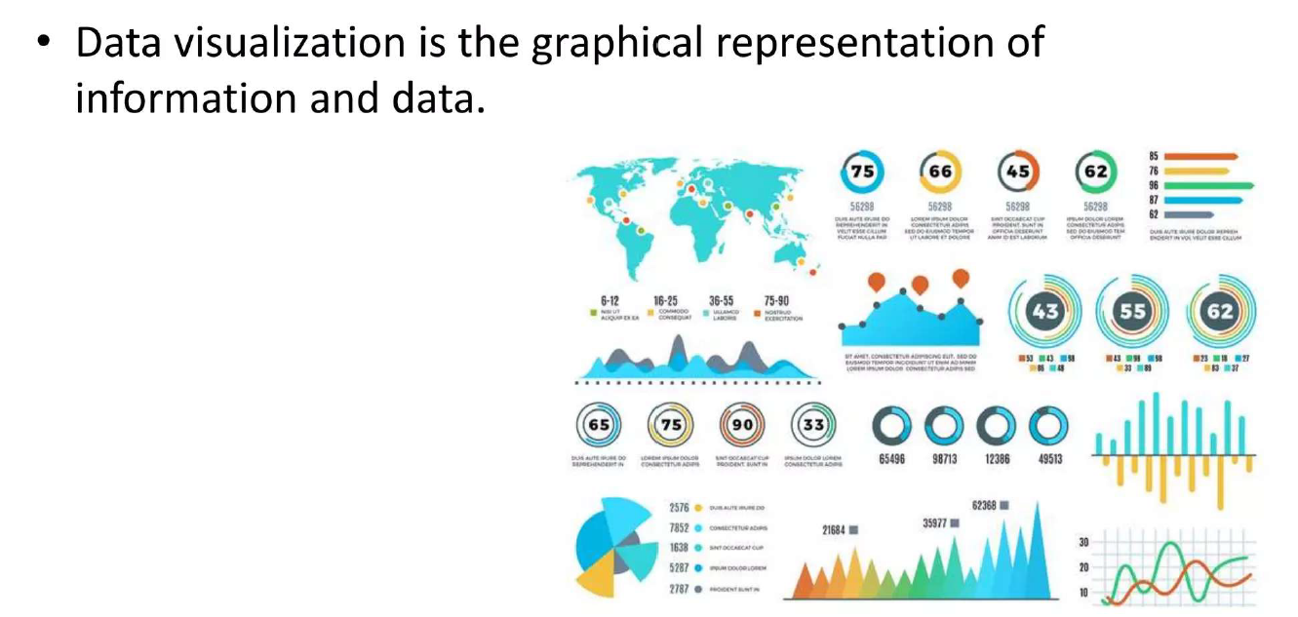
IoT Data Visualization Platform

Slide 15
IoT Data Visualization Platform
Bug Labs Freeboard (https://freeboard.io/) is a leading IoT data visualization platform.
The following use cases definitely vouch for the need for competent visualization tool.
◾ Air Quality: In an effort to provide city bicycle riders with timely, relevant environmental data, Bug Labs teamed with a global wireless carrier to prototype a 3G-connected, GPSenabled, and air-quality sensor that could be attached to city-sponsored rental bikes. When in use, these specially equipped bicycles provide real-time location-tagged air-quality data that is used to create a crowd sourced pollution index map for other bikers to use when planning their routes.
◾ Distillery: The Heising-330, from Bunker Stills, is a novel, modern, Internet-connected, and fully automated continuous still, built by and for the craft distillery. They use dweet. io + Freeboard to provide real-time remote monitoring and diagnostic information to still operators and maintainers.
◾ Humidor: The Humidor Sentinel is a small, Wi-Fi-connected sensor device that fits inside cigar humidors of all sizes and continuously measures humidity, temperature, and lid position information. Both Freeboard and dweet.io are used to provide real-time monitoring of these key quality metrics.

Slide 16
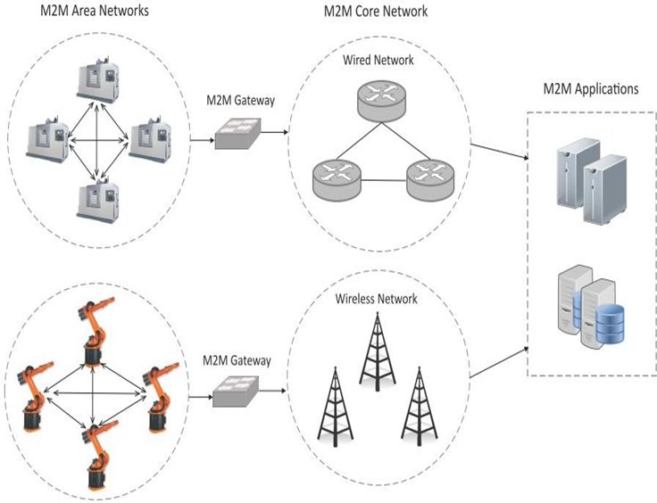
Machine-to-Machine (M2M)
Machine-to-Machine (M2M) refers to networking of machines (or devices) for the purpose of remote monitoring and control and data exchange.
An M2M area network comprises of machines (or M2M nodes) which have embedded hardware modules for sensing, actuation and communication.
Various communication protocols such as ZigBee, Bluetooh, ModBus, M-Bus, Wirless M-Bus, Power Line Communication (PLC), 6LoWPAN, IEEE 802.15.4, etc. finds applications
The wired or wireless communication network provides connectivity to remote M2M area networks.

Slide 17
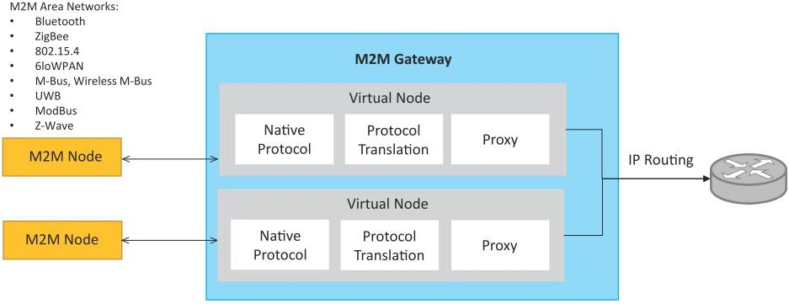
Machine-to-Machine (M2M)
M2M Gateway
Since non-IP based protocols are used within M2M area networks, the M2M nodes within one network cannot communicate with nodes in an external network.
To enable the communication between remote M2M area networks, M2M gateways are used.

Slide 18
Difference between IoT and M2M
Communication Protocols
M2M and IoT can differ in how the communication between the machines or devices happens.
M2M uses either proprietary or non-IP based communication protocols for communication within the M2M area networks.
Machines in M2M vs Things in IoT
The "Things" in IoT refers to physical objects that have unique identifiers and can sense and communicate with their external environment (and user applications) or their internal physical states.
M2M systems, in contrast to IoT, typically have homogeneous machine types within an M2M area network.
Book website: http://www.internet-of-things-book.com

Slide 19
Difference between IoT and M2M
Hardware vs Software Emphasis
While the emphasis of M2M is more on hardware with embedded modules, the emphasis of IoT is more on software.
Data Collection & Analysis
M2M data is collected in point solutions and often in on-premises storage infrastructure.
In contrast to M2M, the data in IoT is collected in the cloud (can be public, private or hybrid cloud).
Applications
M2M data is collected in point solutions and can be accessed by on-premises applications such as diagnosis applications, service management applications, and on- premisis enterprise applications.
IoT data is collected in the cloud and can be accessed by cloud applications such as analytics applications, enterprise applications, remote diagnosis and management applications, etc.
Book website: http://www.internet-of-things-book.com

Slide 20
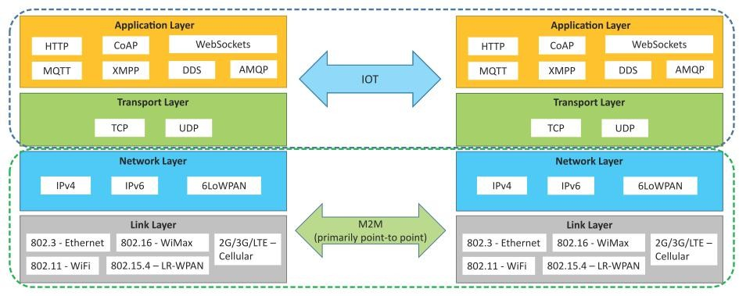
Communication in IoT vs M2M
Book website: http://www.internet-of-things-book.com

Slide 21
Software Defined Networking (SDN) for IoT
SDN (Software-Defined Networking) separates the control plane from the data plane, centralizing network control.
IoT networks involve numerous devices that require efficient, scalable management.
SDN provides flexibility, scalability, and enhanced security in IoT environments.
Simplifies network management.
Provides scalability and flexibility to manage IoT devices.
Enhances security through centralized monitoring.

Slide 22
Software Defined Networking (SDN) for IoT
Challenges in IoT Networks
Device heterogeneity
Managing large data volumes
Network complexity
Key Benefits of SDN for IoT Networks
Scalability - Can handle a large number of IoT devices across various locations.
Centralized Network Control - Enables unified management and policy enforcement for IoT networks.
Dynamic Resource Allocation -Efficiently assigns bandwidth and resources to different IoT devices based on current demand.
Enhanced Security - Monitors network traffic and applies security policies from a centralized controller, mitigating risks.

Slide 23
Key Elements of SDN
Centralized Network Controller
With decoupled control and data planes and centralized network controller, the network administrators can rapidly configure the network.
Programmable Open APIs
SDN architecture supports programmable open APIs for interface between the SDN application and control layers (Northbound interface).
Standard Communication Interface (OpenFlow)
SDN architecture uses a standard communication interface between the control and infrastructure layers (Southbound interface).
OpenFlow, which is defined by the Open Networking Foundation (ONF) is the broadly accepted SDN protocol for the Southbound interface.
Book website: http://www.internet-of-things-book.com

Slide 24
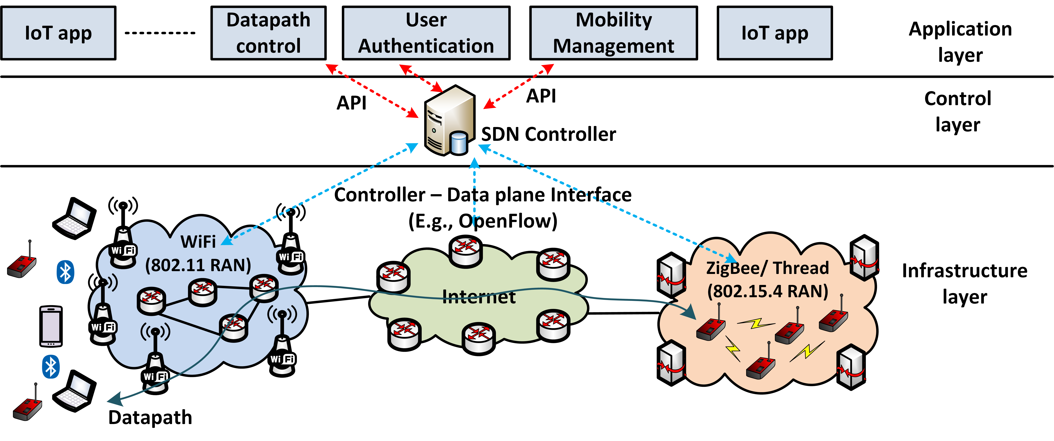
Software Defined Networking for IoT

Slide 25
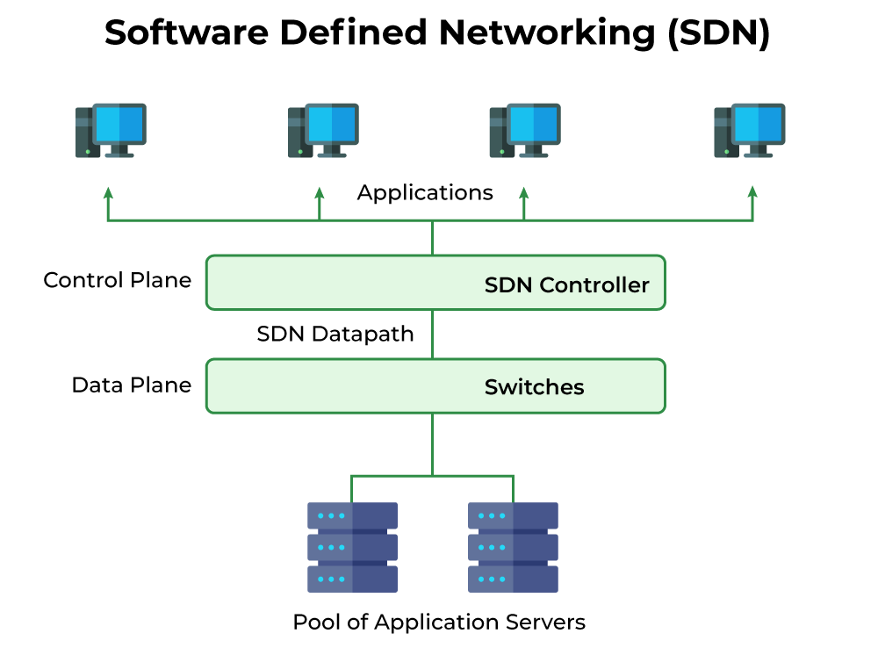
Software Defined Networking for IoT
Separation of Control and Data Planes:
Control Plane: Centralized brain of the network that makes decisions (routing, security).
Data Plane: Handles traffic forwarding based on instructions from the control plane.
Centralized SDN Controller:
A software-based controller manages the entire network.
It tells network devices (switches/routers) how to handle traffic in real-time.
Communicates using protocols like OpenFlow.
Programmability:
Network behavior is programmable, allowing dynamic control and fast responses to changing traffic needs.

Slide 26
Software Defined Networking for IoT
Flow Management:
The SDN controller sets rules for traffic flows, optimizing paths and enforcing policies across the network.
Interfaces:
Northbound (to Applications): Allows apps to control the network.
Southbound (to Devices): Links the controller to network devices.

Slide 27
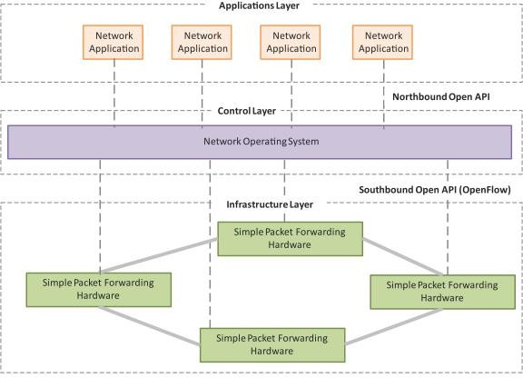

Slide 28
Software Defined Networking for IoT
Use Cases of SDN in IoT
Smart Cities - SDN controls traffic lights, cameras, and environmental sensors for efficient urban management.
Healthcare IoT - Manages the flow of critical data from wearable devices and smart medical systems.
Industrial IoT - Optimizes factory automation and real-time monitoring of equipment for better productivity.
Agriculture - Centralized management of sensors in precision farming for optimizing water and fertilizer use.

Slide 29
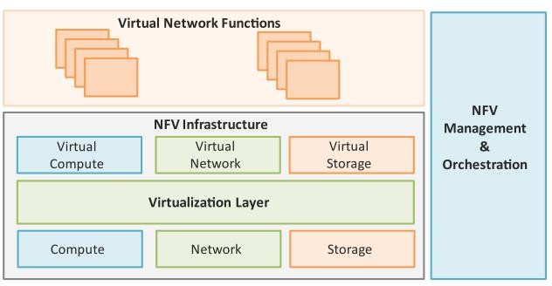
NFV – Network Function Virtualization
Network Function Virtualization (NFV) is a technology that leverages virtualization to consolidate the heterogeneous network devices onto industry standard high volume servers, switches and storage.
NFV is complementary to SDN as NFV can provide the infrastructure on which SDN can run.
Book website: http://www.internet-of-things-book.com

Slide 30
Key Elements of NFV
Virtualized Network Function (VNF):
VNF is a software implementation of a network function which is capable of running over the NFV Infrastructure (NFVI).
NFV Infrastructure (NFVI):
NFVI includes compute, network and storage resources that are virtualized.
NFV Management and Orchestration:
NFV Management and Orchestration focuses on all virtualization-specific management tasks and covers the orchestration and life-cycle management of physical and/or software resources that support the infrastructure virtualization, and the life-cycle management of VNFs.
Book website: http://www.internet-of-things-book.com

Slide 31
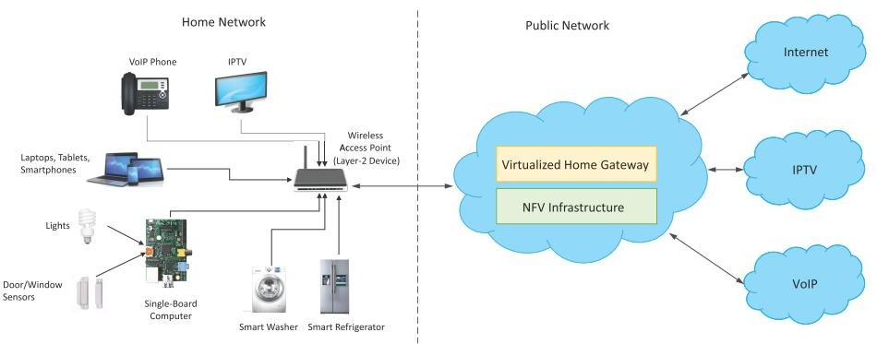
NFV Use Case
NFV can be used to virtualize the Home Gateway. The NFV infrastructure in the cloud hosts a virtualized Home Gateway. The virtualized gateway provides private IP addresses to the devices in the home. The virtualized gateway also connects to network services such as VoIP and IPTV.
Book website: http://www.internet-of-things-book.com

Slide 32
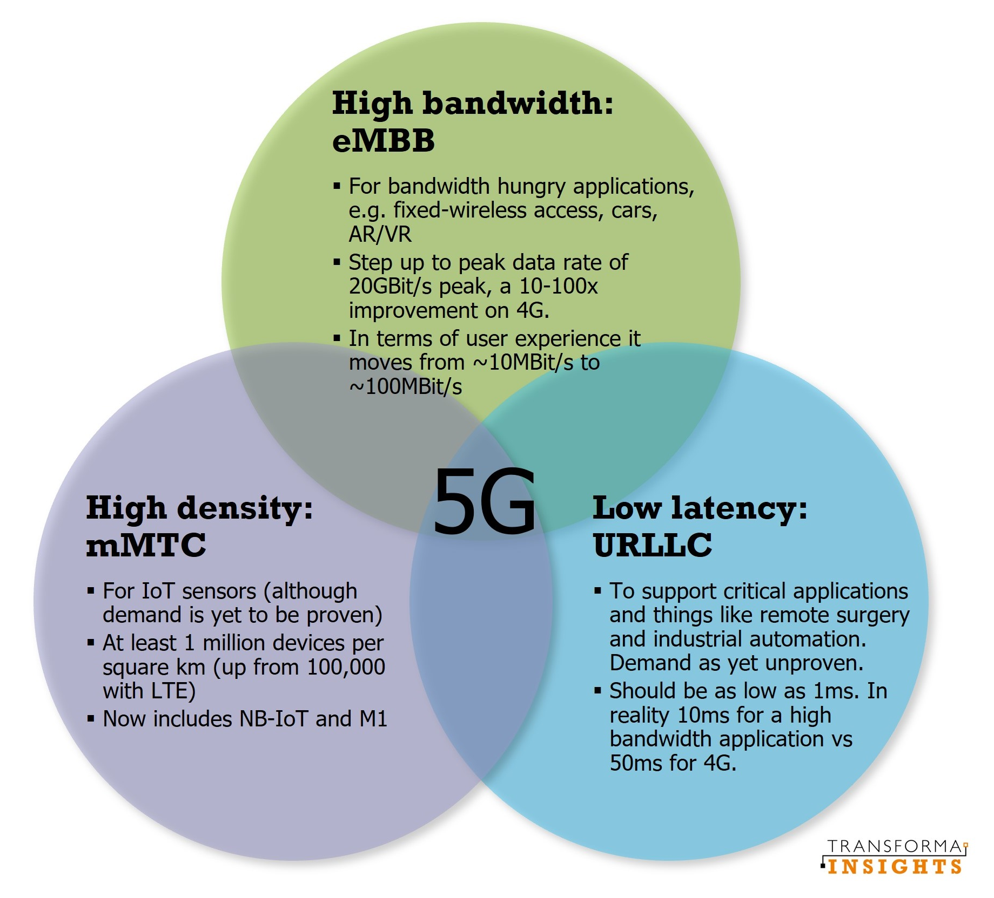
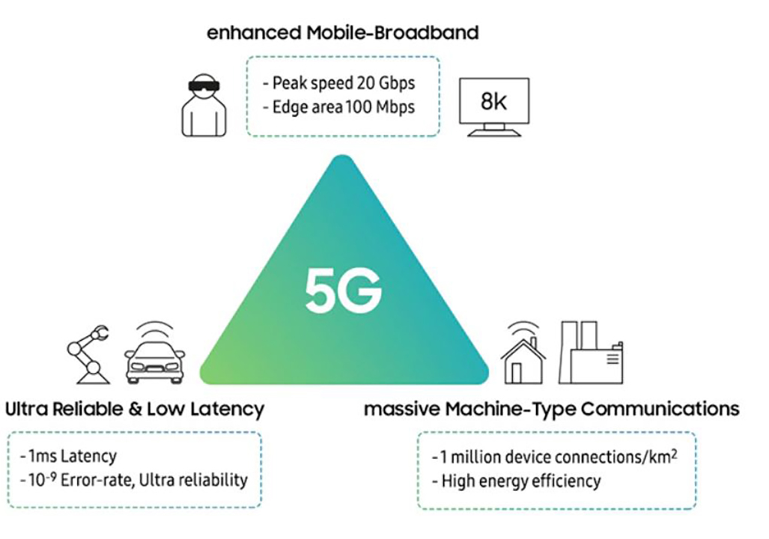
5G Communication in IoT

Slide 33
5G Communication in IoT
Wi-Fi:
Pros: High bandwidth, widely available.
Cons: Limited range, interference in industrial environments.
Bluetooth and Zigbee:
Pros: Low power, short-range communication.
Cons: Not suitable for large-scale industrial networks.
LPWAN (Low Power Wide Area Network):
Examples: LoRaWAN, Sigfox.
Pros: Long-range, low power consumption, ideal for industrial IoT.
Cellular (4G/5G):
Pros: High reliability, wide coverage, better suited for large industrial applications.
High-Speed Data Transmission:
5G supports data rates up to 10 Gbps, enabling real-time data sharing across IoT devices.
Ultra-Low Latency:
Latency as low as 1 millisecond, critical for real-time control and automation of machines.
Massive Device Connectivity:
5G can connect millions of devices per square kilometer, ideal for large-scale IoT deployments in smart factories.
Enhanced Reliability:
Guaranteed reliability and security, crucial for mission-critical applications like robotics, machine control, and smart manufacturing.

Slide 34
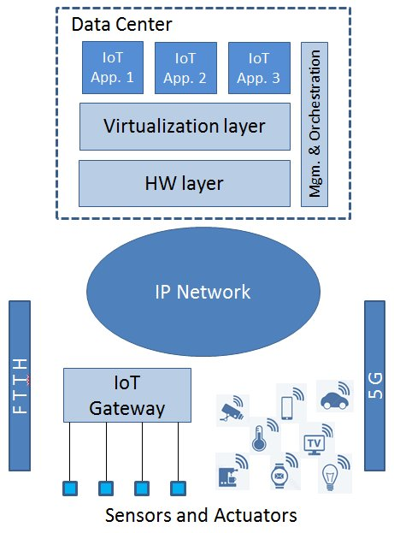
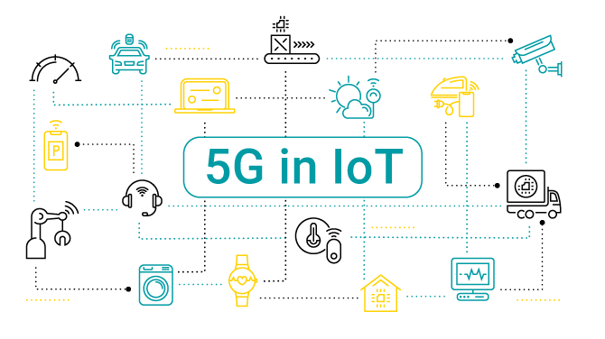
5G Communication in IoT

Slide 35
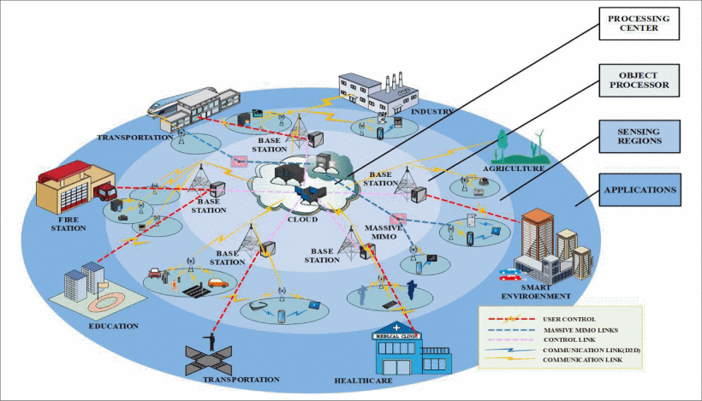
5G Communication in IoT

Slide 36
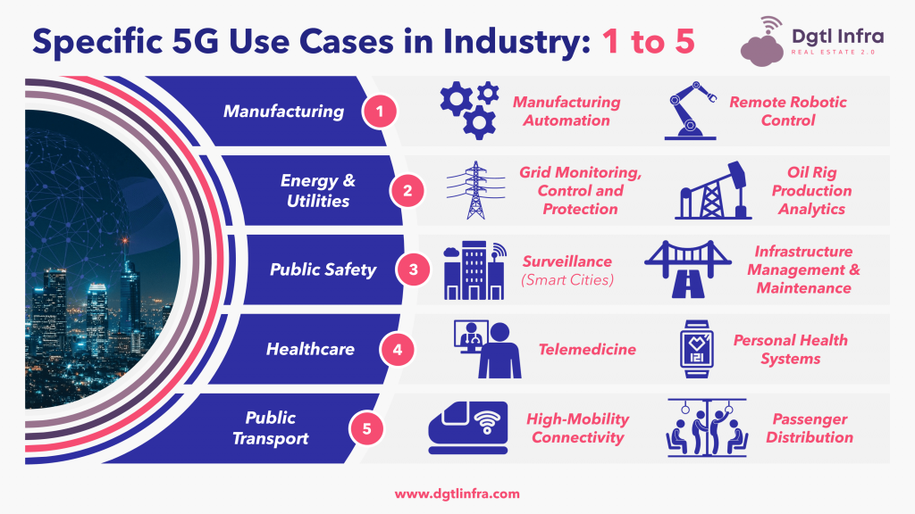
5G Communication in IoT
5G Use Cases in Industry Automation
Smart Manufacturing:
Real-time monitoring of production lines, optimizing efficiency, reducing downtime.
Autonomous Robots:
5G enables robots to work together in real-time for material handling, quality checks, and assembly.
Remote Control and Monitoring:
Machines and processes can be controlled remotely with real-time data feedback, improving flexibility and safety.
Augmented Reality (AR) and Virtual Reality (VR):
AR/VR systems provide real-time support for training, maintenance, and remote troubleshooting in factories.

Slide 37
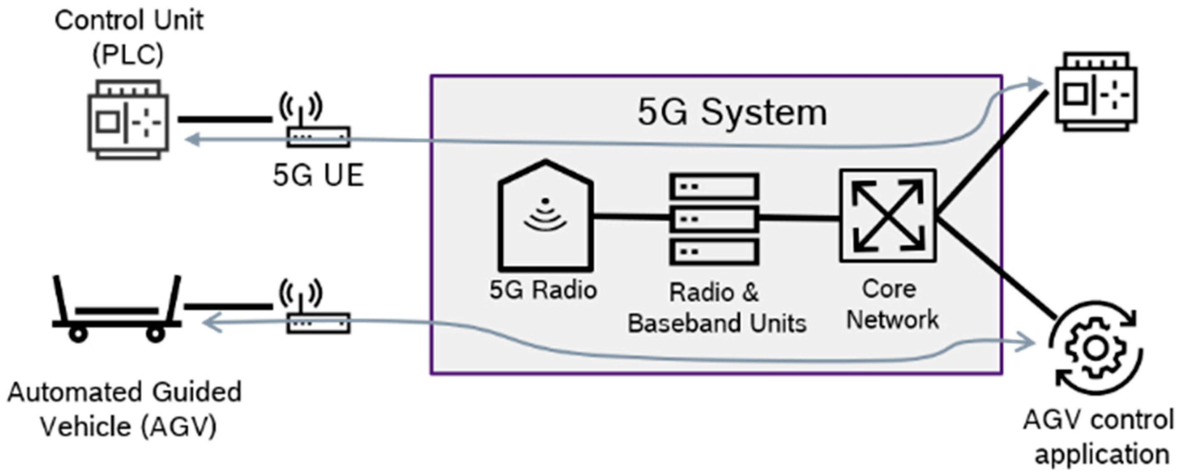

Slide 38
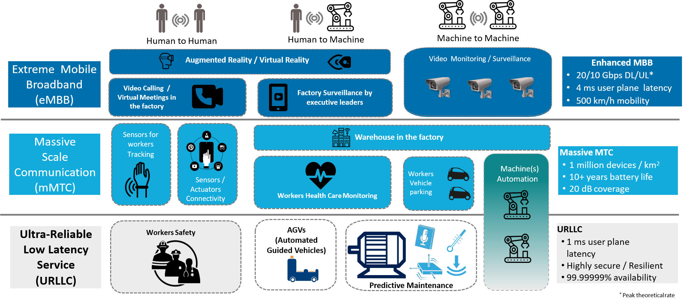
5G Communication in IoT
Summary of 5G use cases

Slide 39
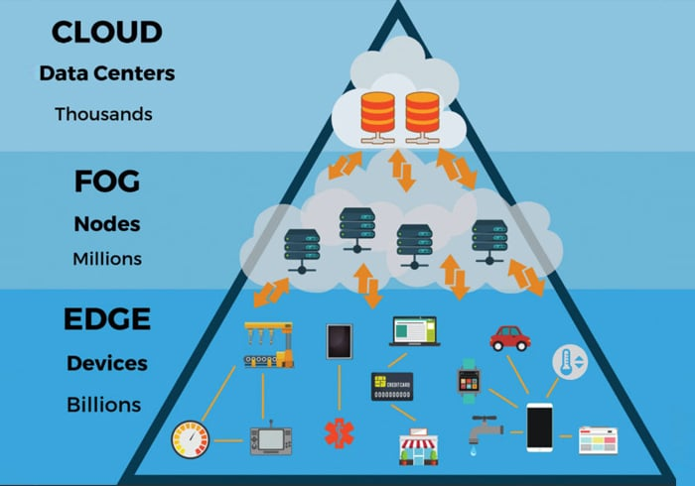
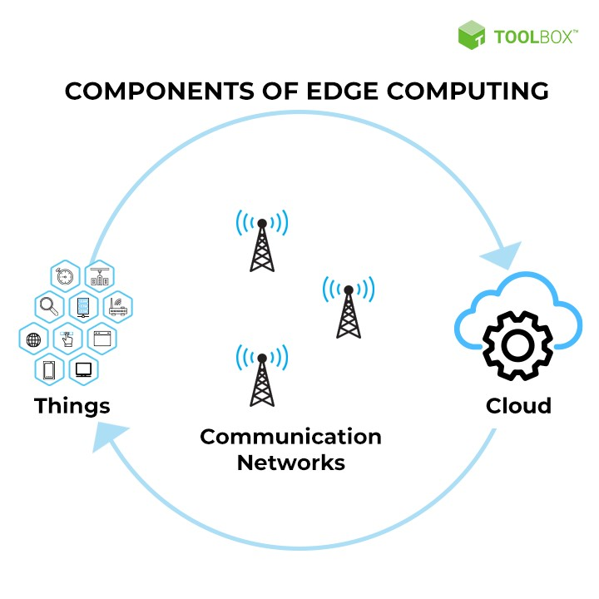
Edge Computing In IoT
Process of computing data closer to the source where it is generated rather than relying solely on a centralized cloud infrastructure.
Instead of sending data from IoT devices to a distant data center or cloud, the data is processed at the "edge" of the network—often on local devices like gateways, routers, or even the IoT devices themselves.
Simplifies processing for massive amounts of terminal data on the cloud.
Notes:
built on the idea that not all data generated by devices needs to be transmitted to centralized locations for processing. Instead, it should be processed closer to where it is created, especially when real-time decision-making is required. This is an evolution from the traditional centralized cloud model toward a decentralized computing approach.

Slide 40
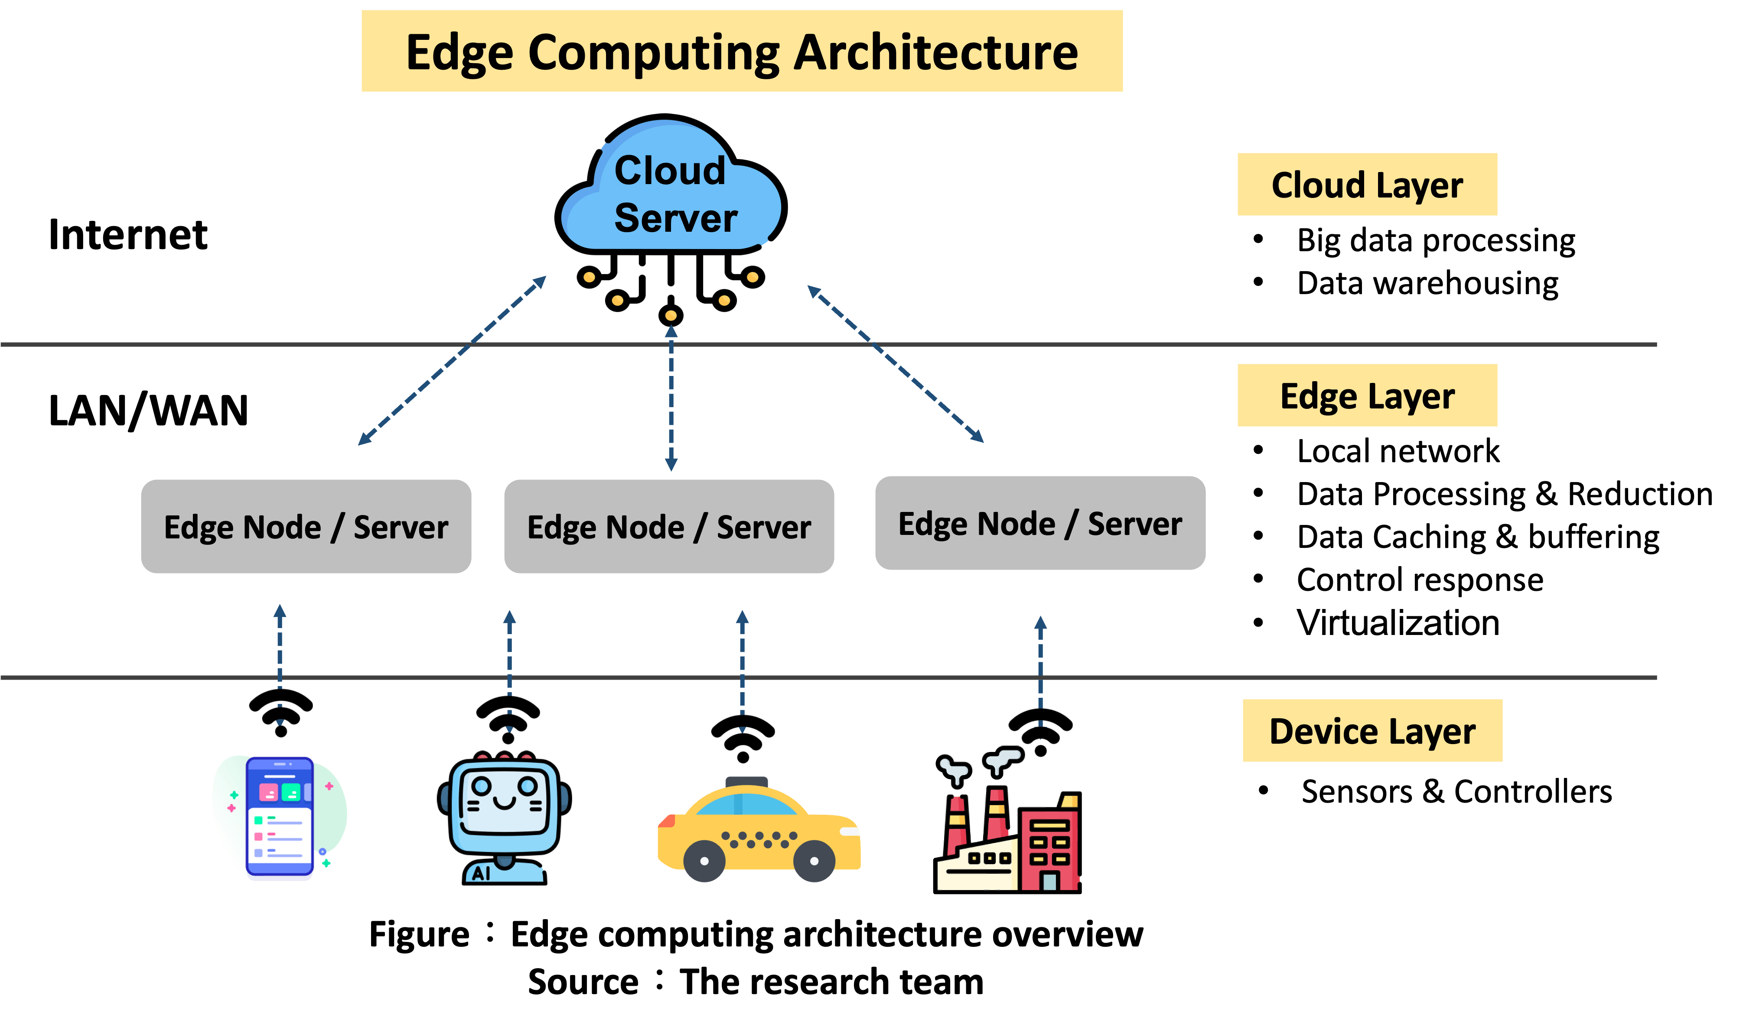

Slide 41
Components of Edge Computing Architecture:
Device Layer (IoT Devices):
Sensors, actuators, and devices generating data (e.g., cameras, machines, smart meters).
Edge Devices/Gateways:
Devices like routers, gateways, or local servers that perform local processing.
These devices collect and process data at the edge, reducing the need to send all data to a remote data center.
Edge Data Centers:
Local data centers or mini cloud hubs that handle more advanced processing tasks that are too complex for edge devices but still need to be processed locally to minimize latency.
Cloud Data Centers:
Centralized cloud platforms handle data that needs long-term storage or high-power computing, often involving AI, machine learning, or extensive analytics.

Slide 42
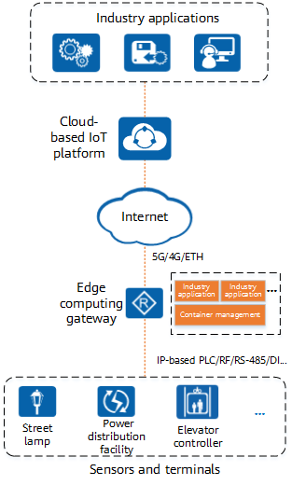
Components of Edge Computing Architecture:
Edge Computing Gateway:
An IoT gateway with edge computing capabilities.
Performs local analysis and processing of large volumes of data from terminal devices.
Supports various industrial IoT interfaces (e.g., PLC, RF, RS-485, DI).
Allows flexible access for various sensors and terminals.
Facilitates software and hardware resource sharing.
Supports container deployment for on-demand application deployment, enabling local data processing.
Cloud-based IoT Platform:
Interconnects with various industry application systems for smart device connectivity.
Utilizes a cloud management architecture for centralized management of numerous terminal devices.
Reduces operational and maintenance costs.
Employs an open architecture with standard northbound APIs for integration with third-party industry applications.

Slide 43
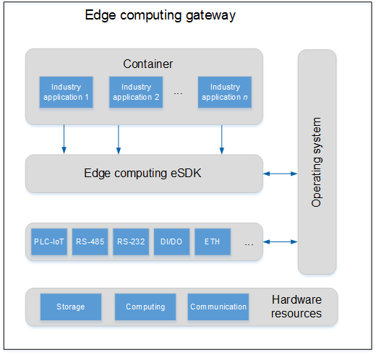
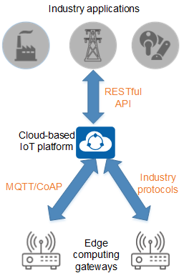

Slide 44
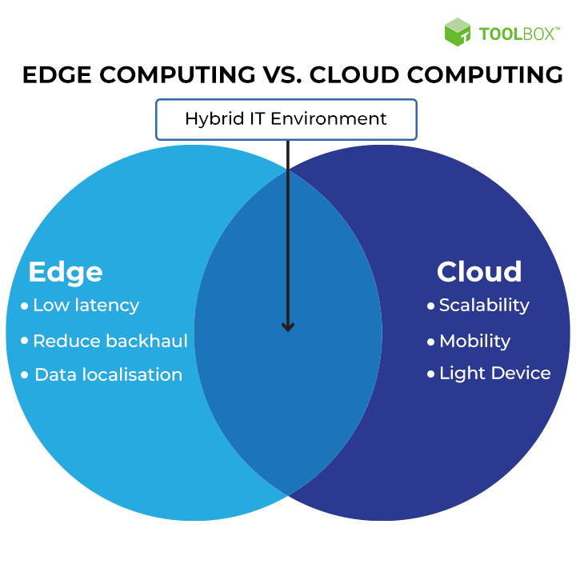
Benefits of Edge Computing in IoT
Real-Time Performance: Essential for time-sensitive operations like autonomous systems or industrial automation.
Lower Latency: Reduced delays in data transmission and decision-making.
Cost Efficiency: Lower bandwidth costs and less reliance on cloud infrastructure.
Data Security: Local data processing improves privacy and mitigates data breaches.
Resilience and Continuity: Local computing ensures that critical processes continue even when network connectivity is weak or disrupted.

Slide 45
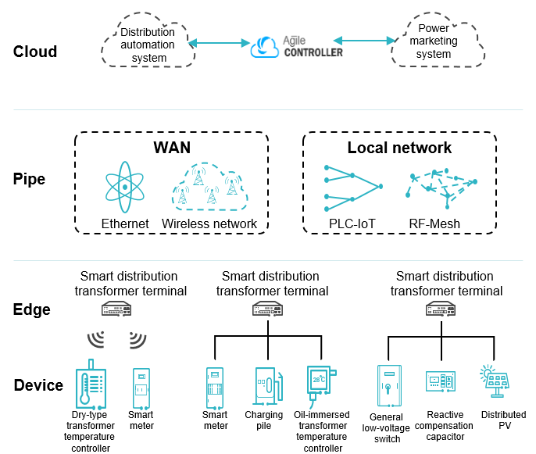
Power Distribution IoT
Cloud: Consists of a master station, micro-application management, and Agile Controller-IoT.
Pipe: Refers to WAN communication networks (e.g., Ethernet, wireless) for data exchange between cloud and edge.
Edge: Deploys an edge computing gateway at the network edge to provide a container platform for service applications.
Device: Utilizes intelligent core communication modules for communication between intelligent terminal devices and the edge computing gateway.
Notes:
1. Cloud:
Consists of a master station, micro-application management, and Agile Controller-IoT.
Functions include DTU management, online device monitoring, fault rectification, asset management, big data analytics, and AI applications.
2. Pipe:
Refers to WAN communication networks (e.g., Ethernet, wireless) for data exchange between cloud and edge.
Local communication networks use technologies like PLC-IoT and RF-Mesh for data transmission between terminal devices and the edge.
3. Edge:
Deploys an edge computing gateway at the network edge to provide a container platform for service applications.
Offers open APIs in containers for application invocation, enabling flexible service deployment.
4. Device:
Utilizes intelligent core communication modules for communication between intelligent terminal devices and the edge computing gateway.
Supports secondary integration of low-voltage devices through open APIs provided by Huawei.

Slide 46
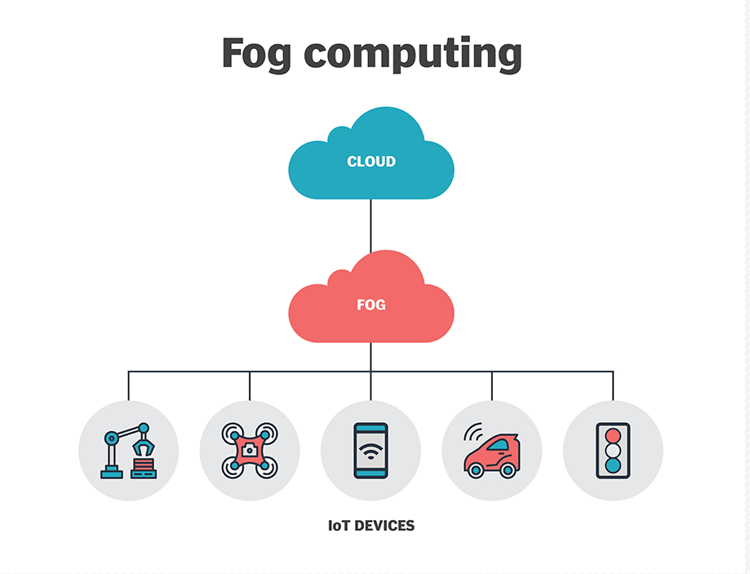
FOG Computing In IoT
Fog Computing is a decentralized computing framework that extends cloud computing capabilities to the edge of the network, enabling data processing closer to the source.
The fog extends the cloud to be closer to the things that produce and act on IoT data .
These devices, called fog nodes, can be deployed anywhere with a network connection.
Any device with computing, storage, and network connectivity can be a fog node.
Examples include industrial controllers, switches, routers, embedded servers, and video surveillance cameras.
its a connection between cloud and your internal network, that processes and stores the data .
Evolved due to the need of
Low Latency Network Connections
Low Bandwidth
Analysis of Data

Slide 47
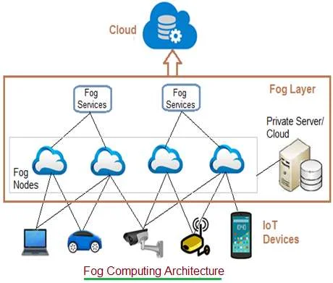
FOG Computing In IoT

Slide 48
FOG Computing In IoT
IoT Devices:
Connected devices using wired and wireless technologies.
Wireless technologies include: Zigbee, Z-Wave, RFID, 6LoWPAN, HART, NFC, Bluetooth, BLE, ISA-100.11A.
IoT protocols include: IPv4, IPv6, MQTT, CoAP, XMPP, AMQP.
Fog Nodes:
Devices with computing, storage, and network connectivity.
Spread across larger regions to support end devices.
Installed in various locations based on applications (e.g., factories, power poles, vehicles).
Examples: Switches, embedded servers, controllers, routers, cameras.
Process high-sensitive data locally.
Fog Aggregate Nodes:
Each fog node has its aggregate node for data analysis.
Analyzes data in seconds to minutes; stores data for hours to days.
Wider geographical coverage with fog data services implemented.
Addresses average-sensitive data.
Remote Cloud:
All aggregate fog nodes connect to the cloud.
Processes, analyzes, and stores time-insensitive or less sensitive data.
Local Server and Cloud:
Utilizes private server/cloud for storing confidential data.
Enhances data security and privacy for firms.

Slide 49
FOG Computing In IoT
Fog Computing vs Cloud Computing
Cloud – A Network that connects same network or different Networks.
Fog – A part of the network that connects same Cloud and Local Datacentre.
Fog computing is a part of Cloud Computing.
Fog Computing vs Edge Computing
Fog computing as the way data is processed from where it is created to where it will be stored.
Edge computing refers just to data being processed close to where it is created.
Fog computing encapsulates not just that edge processing, but also the network connections needed to bring that data from the edge to its end point.
edge computing is a component, or a subset of fog computing.

Slide 50
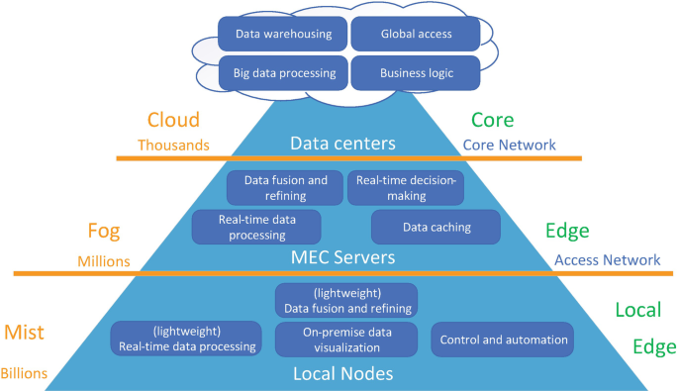
FOG Computing In IoT

Slide 51
Criteria | Edge Computing | Fog Computing | Cloud Computing
Definition | Data processing at or near the data source (IoT devices). | Distributed computing between edge devices and the cloud. | Centralized computing and storage in a remote data center.
Architecture | Operates primarily at the device level with minimal latency. | Involves multiple layers (edge nodes, fog nodes, cloud). | Hierarchical structure focused on centralized resources.
Data Processing | Local data processing with real-time analytics. | Local and regional data processing, often aggregated. | Centralized data processing with potential delays.
Latency | Very low latency, ideal for time-sensitive applications. | Low to moderate latency, better than cloud alone. | High latency, especially for real-time applications.
Bandwidth Usage | Minimizes bandwidth by processing data locally. | Reduces bandwidth usage through data aggregation. | High bandwidth requirements due to data transfer to/from cloud.
Scalability | Limited scalability due to device constraints. | Better scalability through distributed fog nodes. | Highly scalable with extensive resources available in the cloud.
Deployment Complexity | Requires integration with IoT devices; can be complex. | More complex due to multiple layers and nodes. | Generally simpler deployment and management.
Security | Enhanced security through local data processing. | Improved security by limiting sensitive data transfer to the cloud. | Vulnerable to data breaches; centralized data poses risks.
Use Cases | Industrial automation, autonomous vehicles, smart appliances. | Smart cities, transportation systems, industrial IoT. | Big data analytics, web hosting, application services.
Examples | Smart sensors, gateways, and local servers. | Fog nodes like routers, switches, and embedded servers. | Cloud platforms like AWS, Azure, Google Cloud.

Slide 52
Cloud computing
Cloud computing is the on-demand availability of computer system resources, especially data storage (cloud storage) and computing power, without direct active management by the user.
Up until recently, enterprises were forced to deploy and manage their own computing infrastructures.
Cloud computing, which was introduced in 2008, allows enterprises to outsource their computing infrastructure fully or partially to public cloud providers
Cloud provides instant availability,
Visualization
Reliability
Scalability
without the hassles of maintenance or infrastructure.
Public Cloud providers deliver cloud services, on-demand, over the Internet. Enterprises pay only for the CPU cycles, storage, or bandwidth they consume.
Private Cloud solutions are deployed by enterprises in their own data centers and deliver computing services to their internal sub-businesses/users.

Slide 53
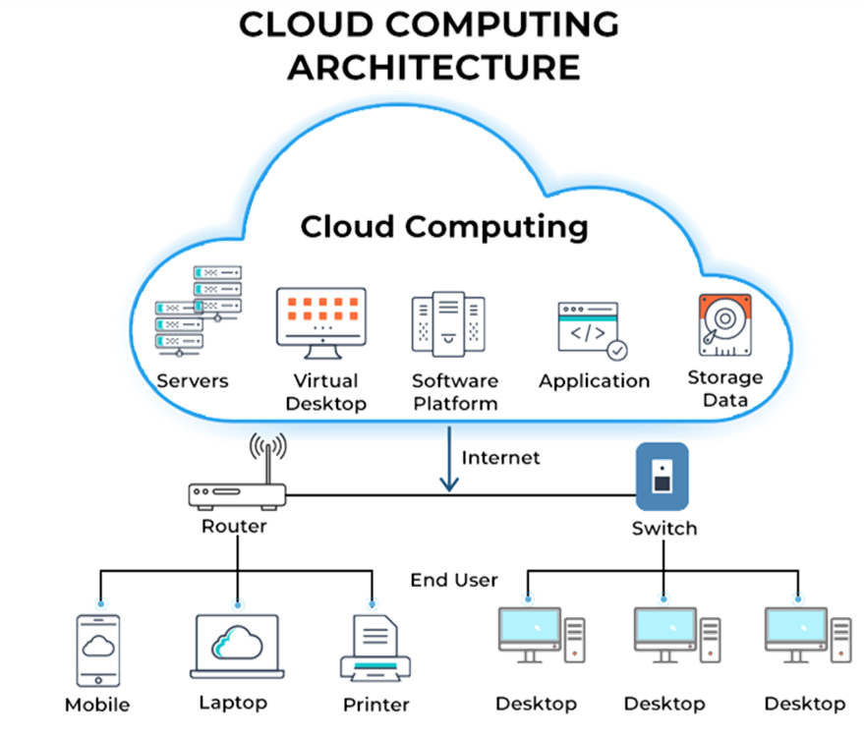
Cloud computing
Instead of storing files on a storage device or hard drive, a user can save them on the cloud, making it possible to access the files from anywhere, as long as they have access to the web.
Cloud can be divided into two different layers:
Front-End
Back-End
Front-End: The layer with which users interact. This layer enables a user to access the data that has been stored in the cloud through cloud computing software.
Back-End: The layer made up of software and hardware, i.e., the computers, servers, central servers, and databases. This layer is the primary component of the cloud and is entirely responsible for storing information securely.

Slide 54
Cloud computing
Characteristics of Cloud computing
On-demand self-service: A consumer can unilaterally provision computing capabilities, such as server time and network storage, as needed automatically without requiring human interaction with each service provider.
Broad network access.: Capabilities are available over the network and accessed through standard mechanisms that promote use by heterogeneous thin or thick client platforms (e.g. mobile phones, tablets, laptops, and workstations)
Resource pooling: The provider’s computing resources are pooled to serve multiple consumers using a multi-tenant model, with different physical and virtual resources dynamically assigned and reassigned according to consumer demand. Resources include storage, processing, memory, and network bandwidth
Rapid elasticity: If the level of computing and storage exceeds the allocated level, the cloud will dynamically stretch to accommodate the demand without any customer interaction.
Measured service: Cloud systems automatically control and optimize resource use by leveraging a metering capability at some level of abstraction appropriate to the type of service (e.g. storage, processing, bandwidth, and active user accounts.

Slide 55
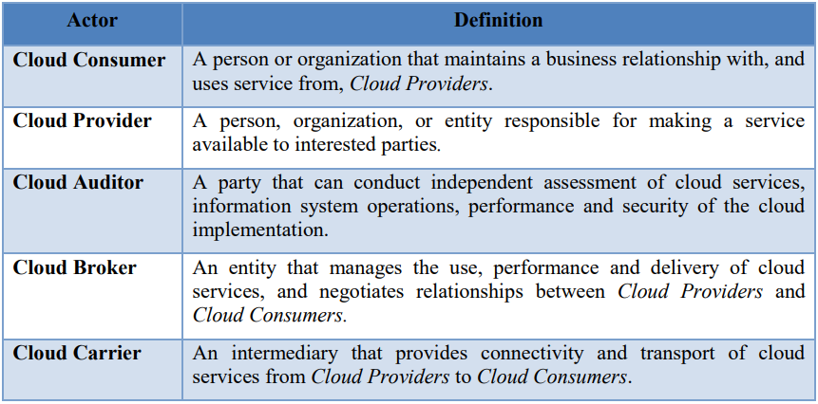
Cloud computing
Actors of Cloud computing
An actor is an entity (a person or an organization) that participates in a transaction or process and/or performs tasks in cloud computing.

Slide 56
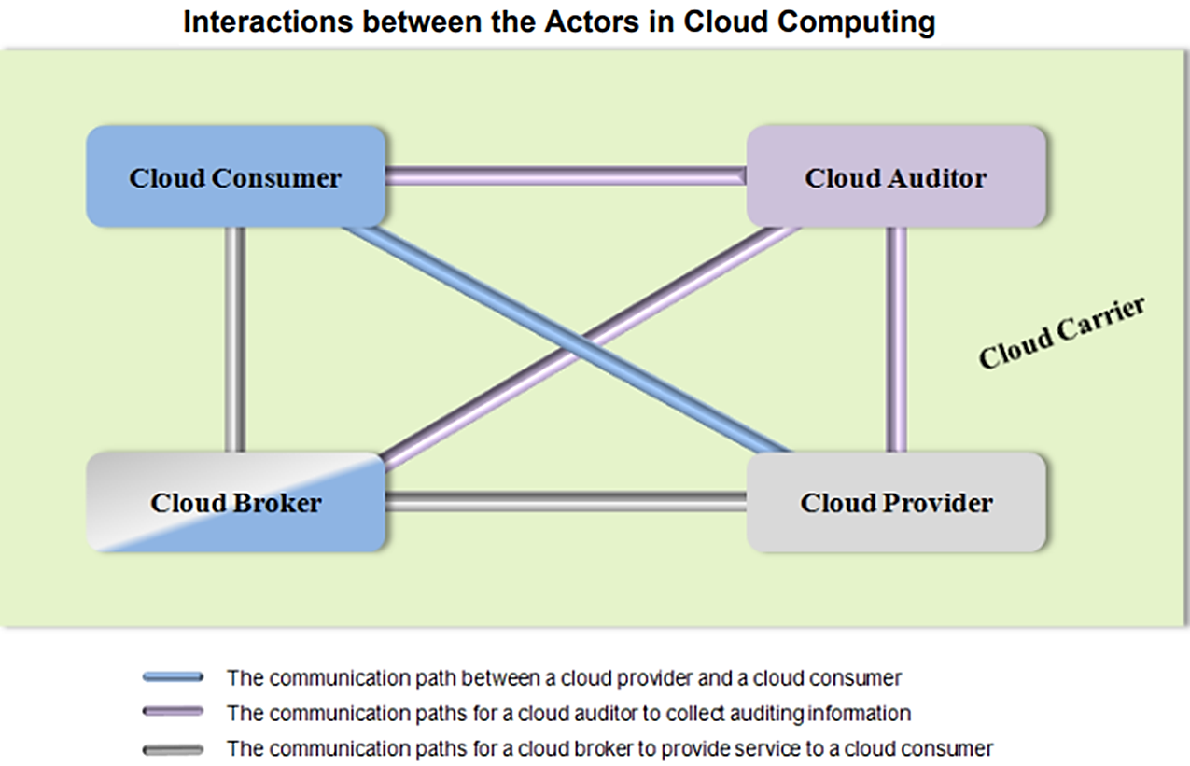
Cloud computing
A cloud consumer may request cloud services from a cloud provider directly or via a cloud broker.
A cloud auditor conducts independent audits and may contact the others to collect the necessary information.

Slide 57
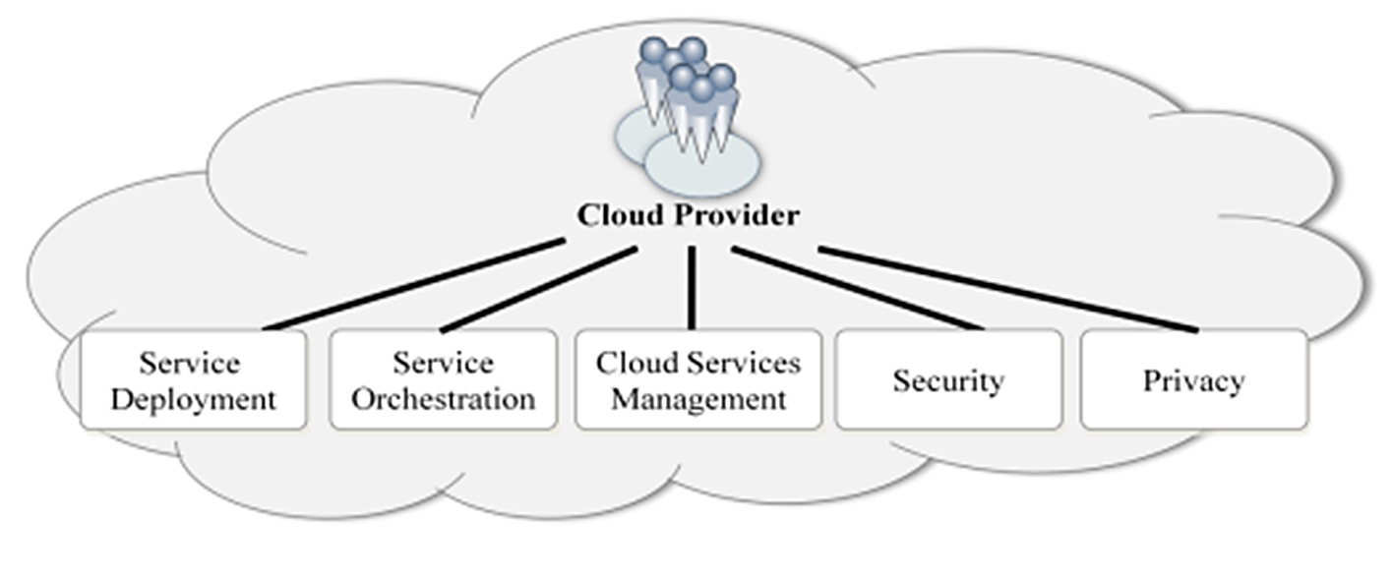
Cloud computing
Cloud Provider Activities
A Cloud Provider acquires and manages the computing infrastructure required for providing the services, runs the cloud software that provides the services, and makes arrangements to deliver the cloud services to the Cloud Consumers through network access.
A Cloud Provider’s activities can be described in five major areas

Slide 58
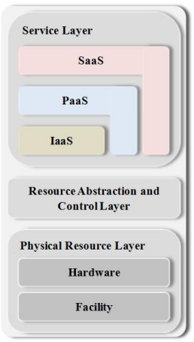
Cloud computing
Service Orchestration
Service Orchestration refers to the composition of system components to support the Cloud Providers’ activities in arrangement, coordination and management of computing resources in order to provide cloud services to Cloud Consumers
There are three forms of services in service layer
IaaS (Infrastructure-as-a Service): Providing storage, software, and network online in the cloud
PaaS (Platform-as-a Service): Access to languages, libraries, APIs, and services
SaaS(Software-as-a Service) offers customized applications
Resource abstraction and control layer contains system components that Cloud Providers use to provide and manage access to the physical computing resources through software abstraction.
Physical resource layer includes all the physical computing resources like computers, networks, storage device, etc.

Slide 59
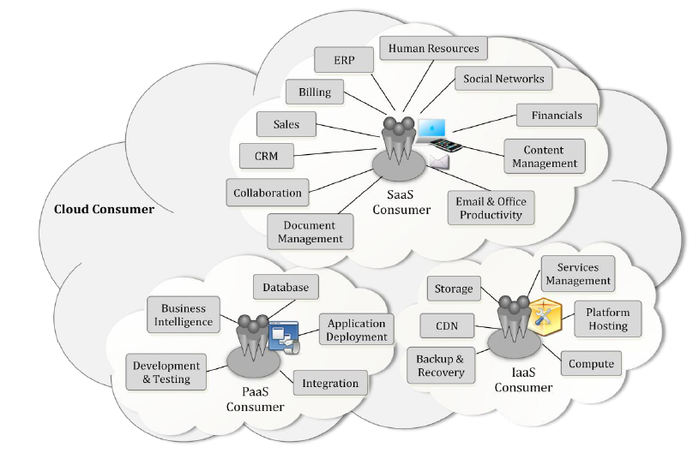
Cloud computing
Cloud Services

Slide 60
Cloud computing
1. Software as a Service (SaaS)
The capability provided to the consumer to use the provider’s applications running on a cloud infrastructure.
The applications are accessible from various client devices through either a thin client interface, such as a web browser (e.g. web-based email), or a program interface.
The consumer does not manage or control the underlying cloud infrastructure including network, servers and operating systems.
Have control over only certain user-specific application configuration settings.
The consumers of SaaS can be
Organizations that provide access to software applications,
End users who directly use software applications
Software application administrators who configure applications for end-users.
SaaS consumers can be billed based on
The number of end users,
The time of use,
The network bandwidth consumed,
The amount of data stored

Slide 61
Cloud computing
2. Platform as a Service (PaaS)
The capability provided to the consumer is to deploy onto the cloud infrastructure consumer-created or acquired applications created using programming languages, libraries, services, and tools supported by the provider.
The consumer does not manage or control the underlying cloud infrastructure but has control over the deployed applications and possibly configuration settings for the application-hosting environment.
PaaS consumers can be
Application developers who design and implement application software,
Application testers who run and test applications in cloud-based environments,
Application deployers who publish applications into the cloud, and
Application administrators who configure and monitor application performance.

Slide 62
Cloud computing
PaaS consumers can be billed according to
Processing,
Database storage and
Network resources
consumed by the PaaS application
The PaaS Cloud Provider typically also supports PaaS Cloud Consumer by providing tools such as:
Integrated development environments (IDEs),
Development version of cloud software,
Software development kits (SDKs), deployment and management tools.

Slide 63
Cloud computing
3. Infrastructure as a Service (IaaS)
The capability provided to the consumer is to provide processing, storage, networks, and other fundamental computing resources where the consumer is able to deploy and run arbitrary software, which can include operating systems and applications.
The consumer does not manage or control the underlying cloud infrastructure but has control over operating systems, storage, and deployed applications; and possibly limited control of select networking components (e.g., host firewalls).
The consumers of IaaS can be
System developers,
System administrators and
IT managers who are interested in creating, installing, managing and monitoring services for IT infrastructure operations.

Slide 64
Cloud computing
IaaS consumers are provisioned with the capabilities to access these computing resources and are billed according to:
The amount or duration of the resources consumed, such as CPU hours used by virtual computers,
Volume and duration of data stored,
Network bandwidth consumed,
Number of IP addresses
The Cloud Provider runs the cloud software necessary to makes computing resources available to the IaaS Cloud Consumer through a set of service interfaces and computing resource abstractions, such as virtual machines and virtual network interfaces.
The IaaS Cloud Consumer in turn uses these computing resources, such as a virtual computer, for their fundamental computing needs Compared to SaaS and PaaS Cloud Consumers
An IaaS Cloud Consumer has access to more fundamental forms of computing resources

